Slide 1
A Machine Learning Approach to Solve Partial Differential Equations
Nathaniel Jones
Department of Mathematics
West Chester University
Research & Creative Activity Day
04/17/2024

Slide 2
Why Solve PDEs With AI?
Traditional numerical methods are often great, but can be prone to instability
Some problems extremely difficult to solve:
Inverse problems
Problems with incomplete initial conditions (e.g. weather modeling)
Physics-informed Neural Networks (PINNs) are a promising new way to tackle these issues
Main benefit is robustness obtained from continuous model

Slide 3
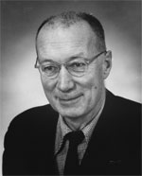
Burgers' Equation Background
Model of turbulence in compressible fluids (such as gases)
Equation first appears in Bateman (1915)
Named after J.M. Burgers for his treatise on the subject in 1948
Jump discontinuity in the solution adds difficulty in developing numerical methods
Johannes Martines Burgers
(source: University of Maryland)

Slide 4
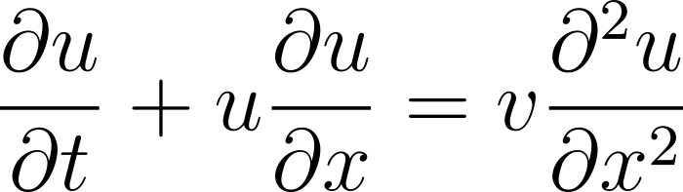
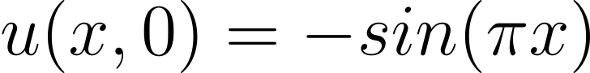
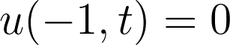
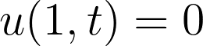
Burgers' Equation Initial Boundary Value Problem
Governing Equation
Initial Condition
Boundary Condition

Slide 5

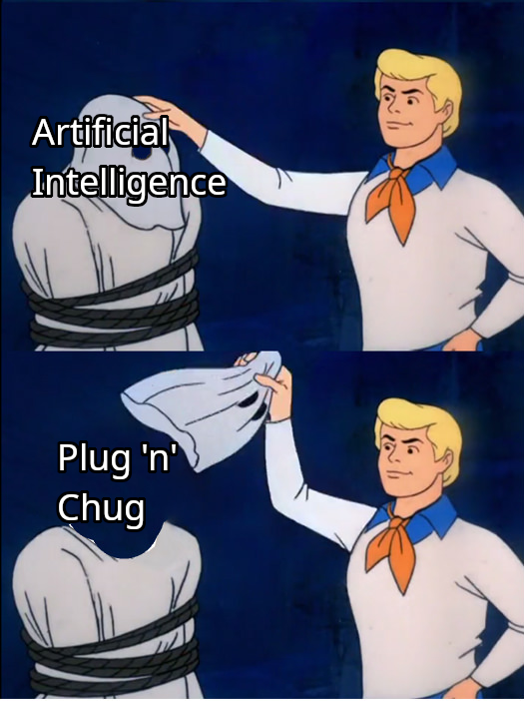
"Artificial Intelligence"

Slide 6
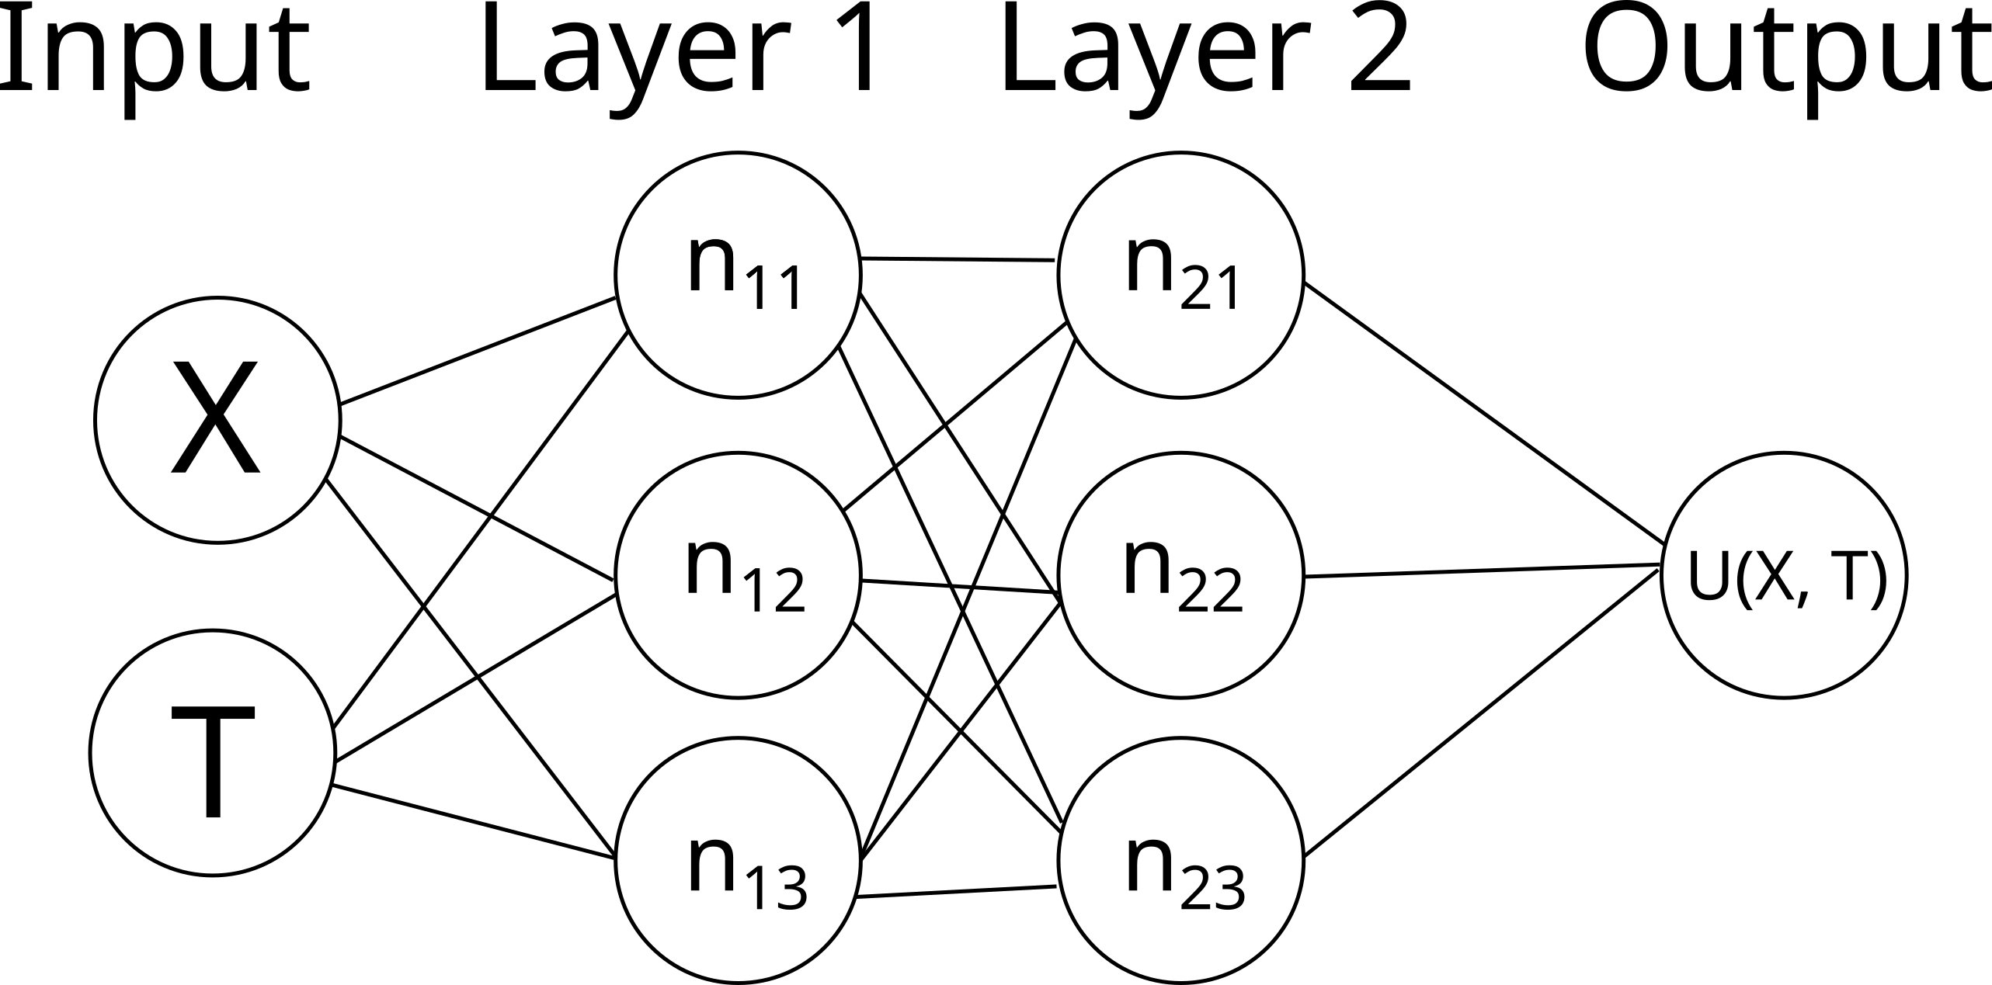
Inside a Neural Network (simplified)

Slide 7
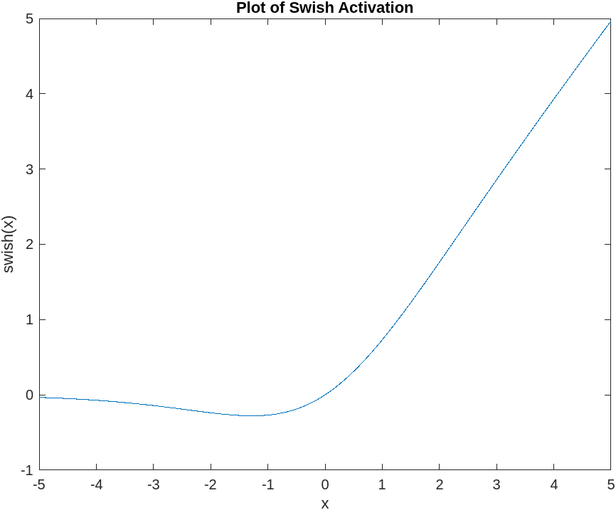
Swish Activation Function

Slide 8
How to Train Your Neural Network
How do we get neural network to output the solution to the IBVP?
Find the weights that minimize the loss function:
Minimization is done via steepest descent with respect to the network weights

Slide 9
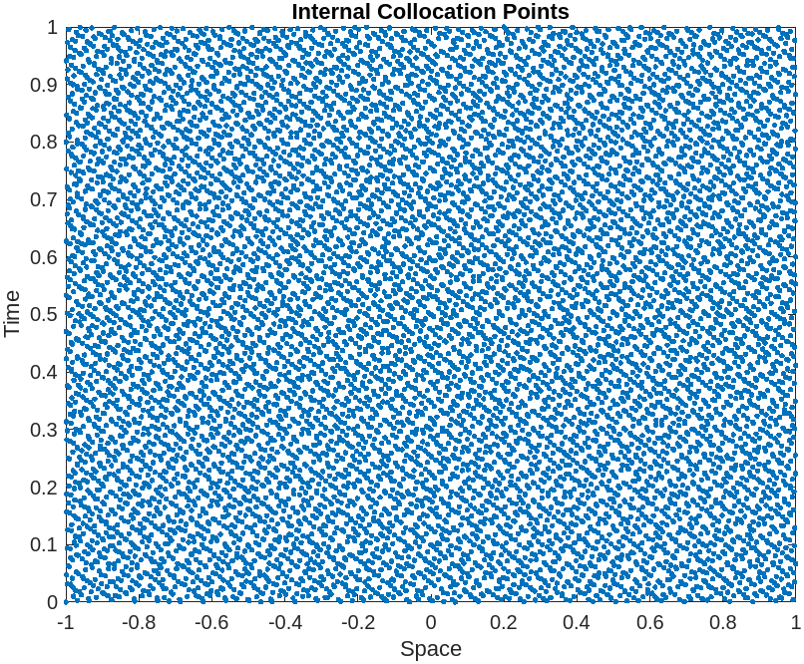
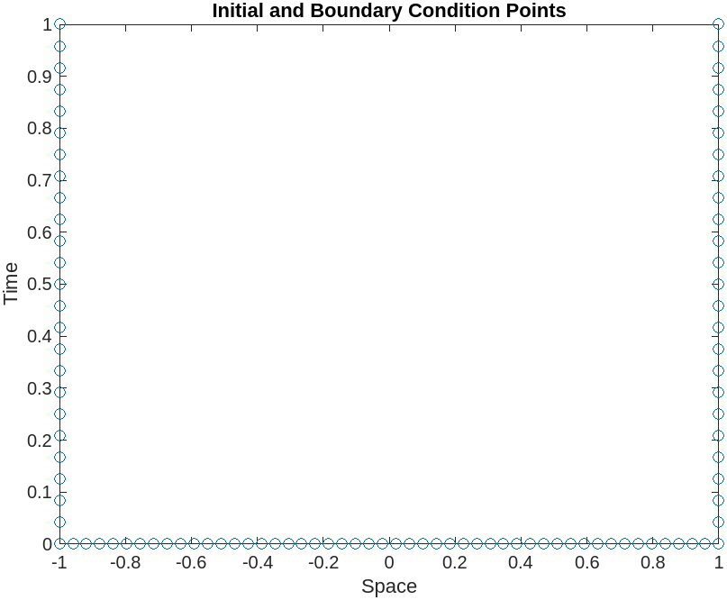
Physics Informed Neural Net Training Process
Does the network's solution evolve correctly at these points?
Does the network have the correct output at these points?

Slide 10
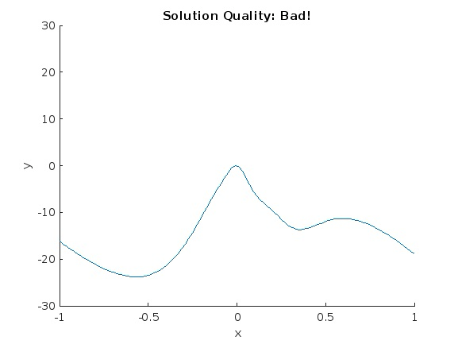
Vary Weights to Minimize the Loss Function

Slide 11
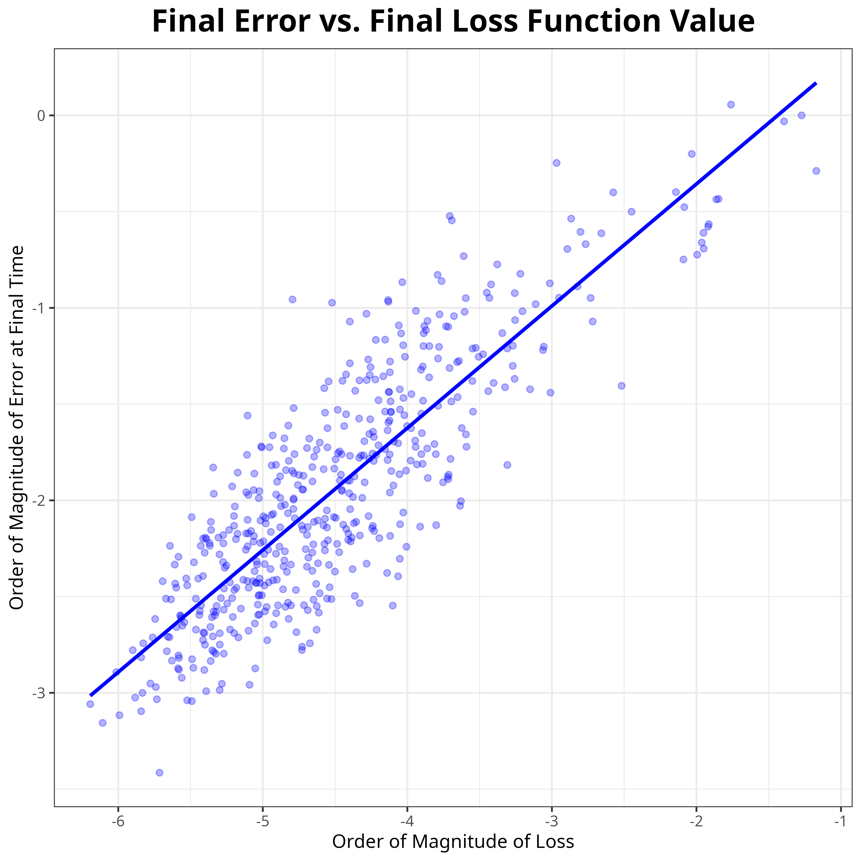
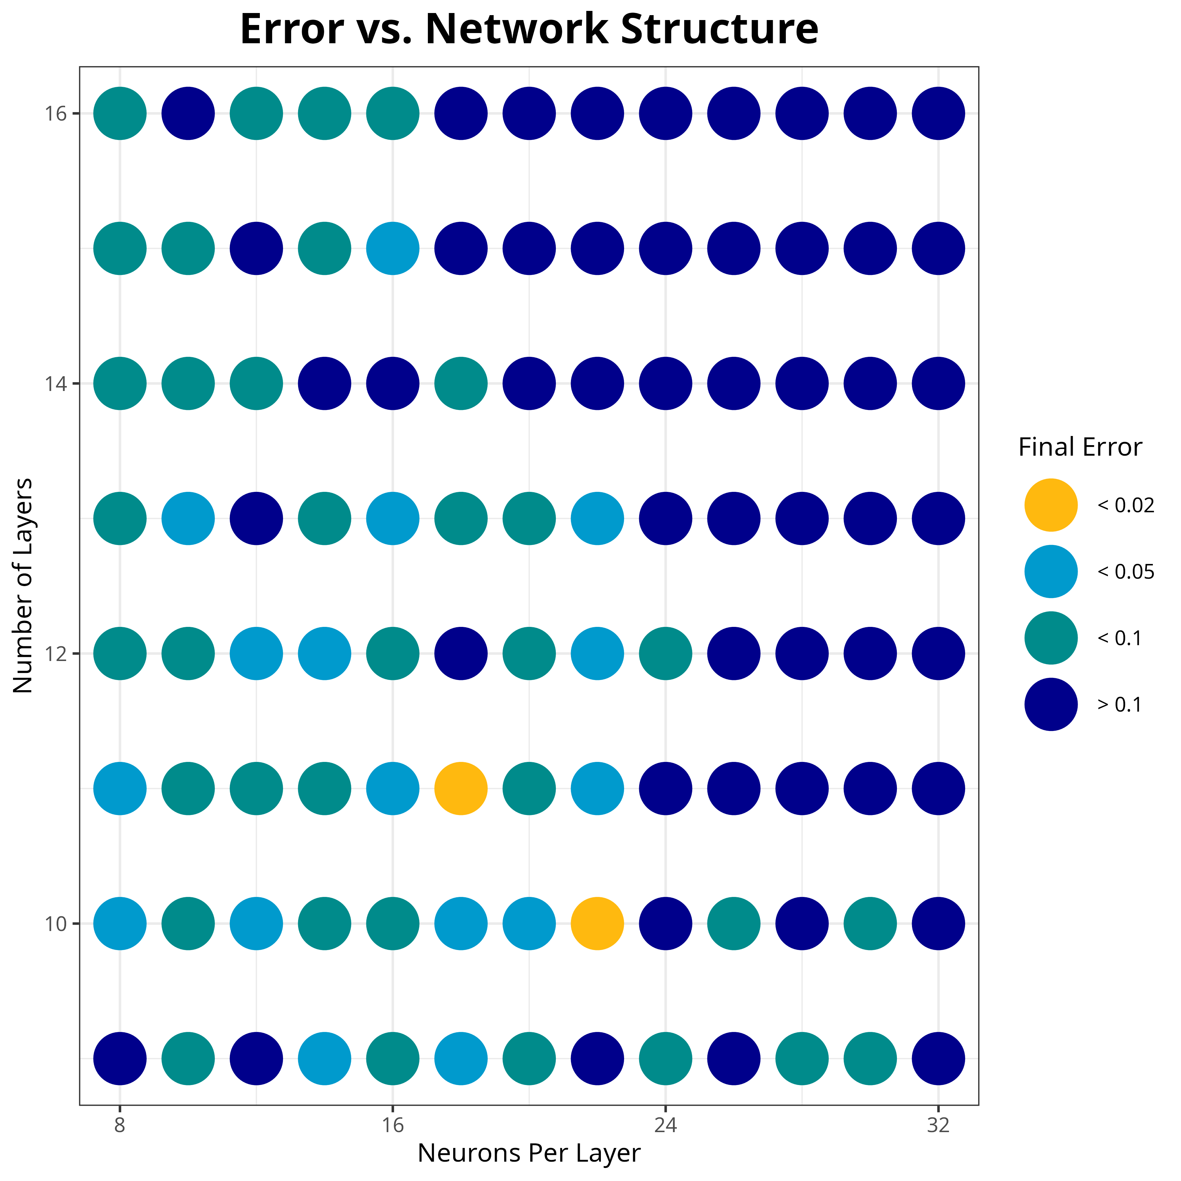
PINNs Experiment Results

Slide 12
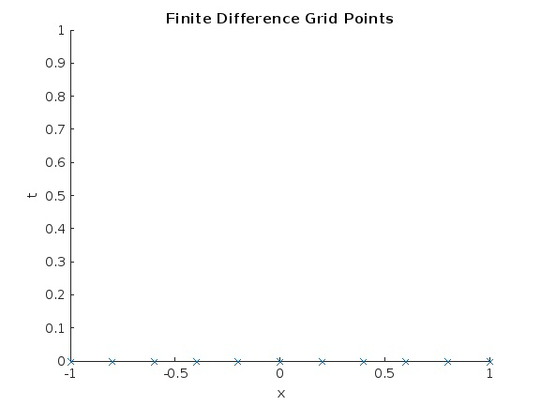
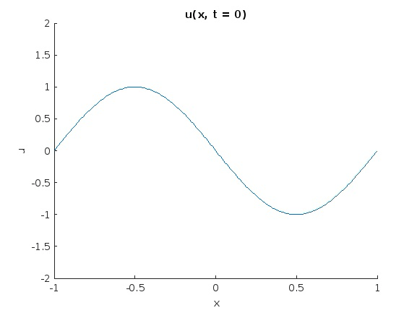
Traditional Finite Difference Method
Solution to IVBP is approximated at grid points
First order in time, second order in space
Point-to-point update method

Slide 13
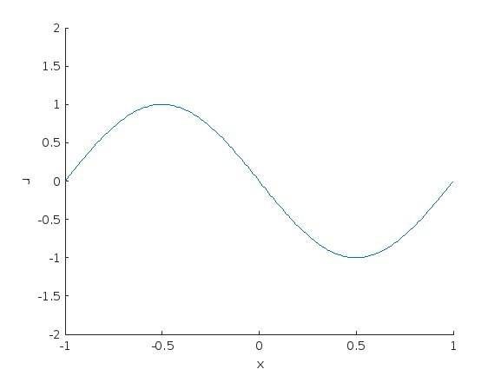

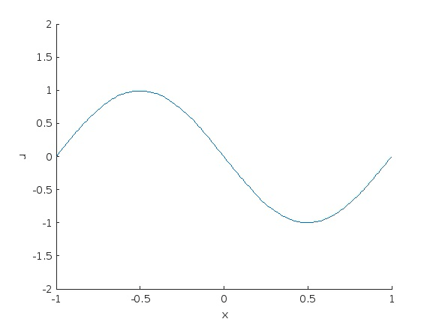
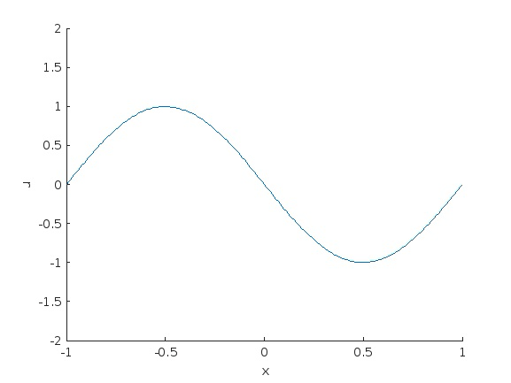
Finite Difference
PINNs
Viscosity = 0.0031
Viscosity = 0.0062

Slide 14

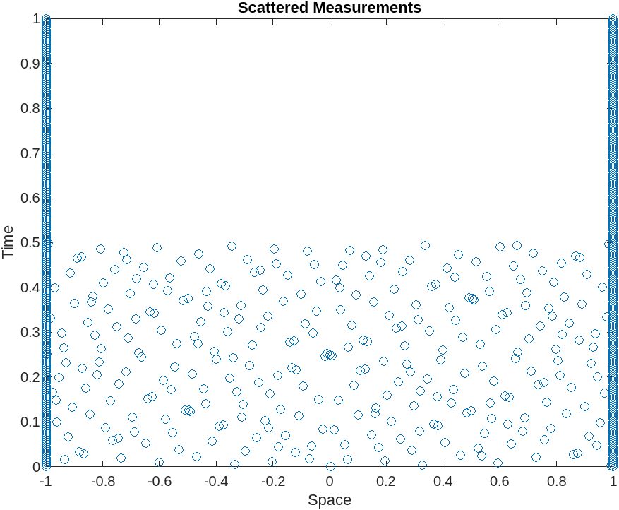
PINNs with Incomplete Initial Condition

Slide 15
The Tradeoff
What we gain in robustness, we lose a lot in speed
V = 0.0031 | Error at Final Time | Runtime (seconds)
PINNs | 0.0618 | 490.732
Finite Difference | 0.0589 | 0.002

Slide 16
Conclusion
PINNs offer a lot in terms of robustness and ease-of-use
But they won't replace traditional methods entirely
One more tool in the toolbox to solve difficult problems

Slide 17
References
Bateman, H. (1915). Some recent researches on the motion of fluids. Monthly Weather Review, 43(4), 163-170. https://doi.org/10.1175%2F1520-0493%281915%2943%3C163%3ASRROTM%3E2.0.CO%3B2
Burgers, J. M. (1948). A mathematical model illustrating the theory of turbulence. Advances in applied mechanics, 1, 171-199. https://doi.org/10.1016/S0065-2156(08)70100-5
Karniadakis, G. E., Kevrekidis, I. G., Lu, L., Perdikaris, P., Wang, S., & Yang, L. (2021). Physics-informed machine learning. Nature Reviews Physics, 3(6), 422-440.
MathWorks. (2023). Solve Partial Differential Equations Using Deep Learning. MATLAB and Simulink Help Center. https://www.mathworks.com/help/deeplearning/ug/solve-partial-differential-equations-using-deep-learning.html
Ramachandran, P., Zoph, B., & Le, Q. V. (2017). Searching for activation functions. arXiv preprint arXiv:1710.05941.

